Slide 1
IBM Project - Malware Detection
Group 22
Sandeep Rajakrishnan, Sudhay Senthilkumar, Karthik Shriram

Slide 2
Description of project
Detection and Prevention of Advanced Persistent Threat (APT) activities in heterogeneous networks using SIEM and Deep Learning

Slide 3
Common features
From the 3 datasets obtained namely UNSW_NB15, IoT Botnet and NSL KDD, we were able to find out the influencing features and common features across these datasets.
Our observation also includes a multiclass classified output with various types of attacks like DoS, Backdoor, Reconnaissance, etc…
Hence, using these common features, we understand that when a new data point is provided and asked to classify under a type of attack with these respective columns’ data, we can find it’s type of attack.
protocol
service
state
duration
category / attack_cat / labels
spkts
dpkts
src_bytes
dest_bytes
state

Slide 4
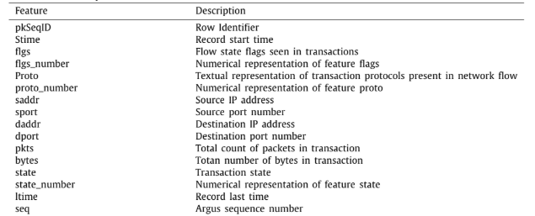
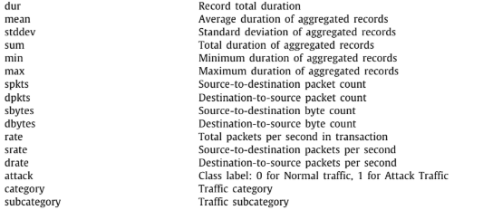
Dataset Description
The dataset we have considered is UNSW_2018_IoT_Botnet_Full5pc_4
The meaning of each column has been described below.

Slide 5
Algorithm Used and Approach
We have used the Support Vector Machine Algorithm on the dataset to obtain the confusion matrix and a classification report.
To begin, we have performed :
Encoding - To give integer representations to strings
Scaling - Used StandardScaler() - to normalize all values
Obtained correlation between columns to find influential attributes
Split dataset into Test and Train datasets
Applied SVM algorithm and obtained a predicted dataset with test set
Compared with actual test dataset so as to obtain performance metrics

Slide 6
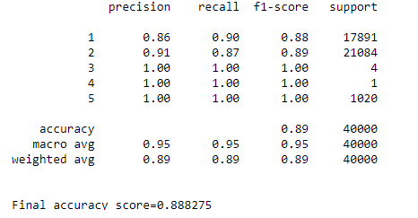
Performance Metrics
Accuracy Score = 0.888275
Algorithm Used : SVM

Slide 7
References
Towards the development of realistic botnet dataset in the Internet of Things for network forensic analytics: Bot-IoT dataset
Link to dataset:
https://raw.githubusercontent.com/defcom17/NSL_KDD/master/KDDTrain%2B.csv
https://cloudstor.aarnet.edu.au/plus/s/umT99TnxvbpkkoE?path=%2FCSV%2FTraning%20and%20Testing%20Tets%20(5%25%20of%20the%20entier%20dataset)%2FAll%20features

